Slide 1
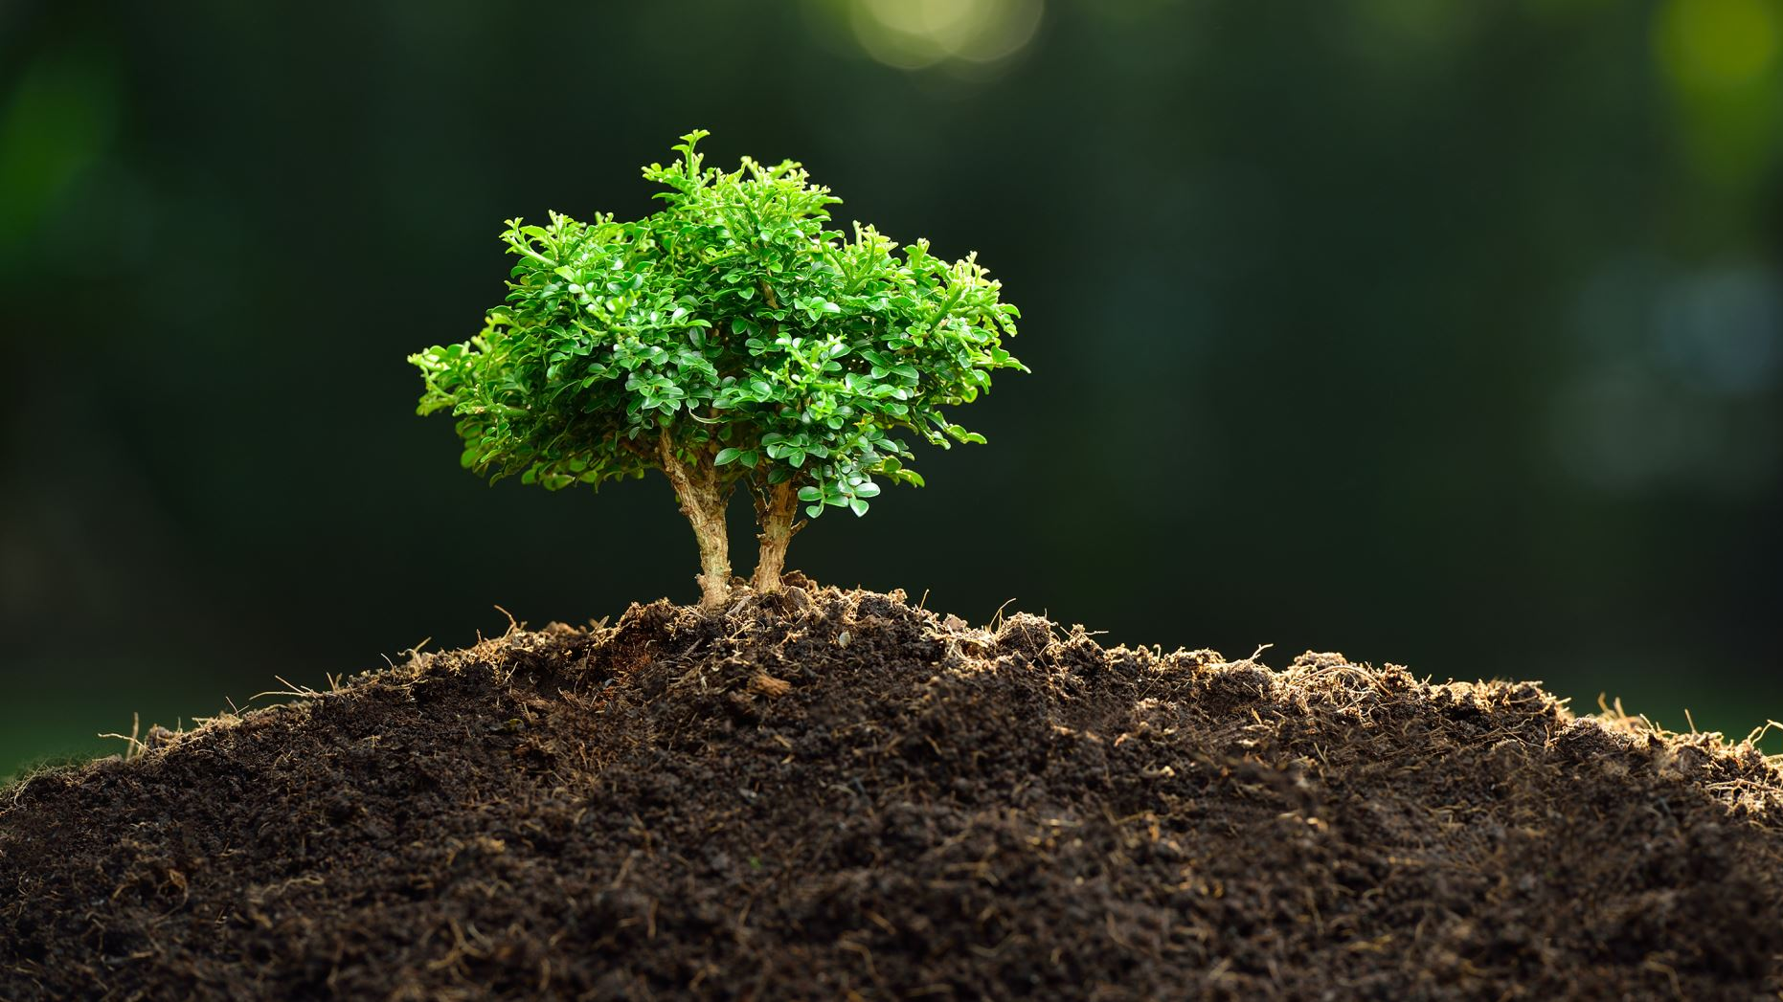
Benefit-Cost Analysis of Urban Trees
Isaiah Sarria and Thomas Risalvato

Slide 2
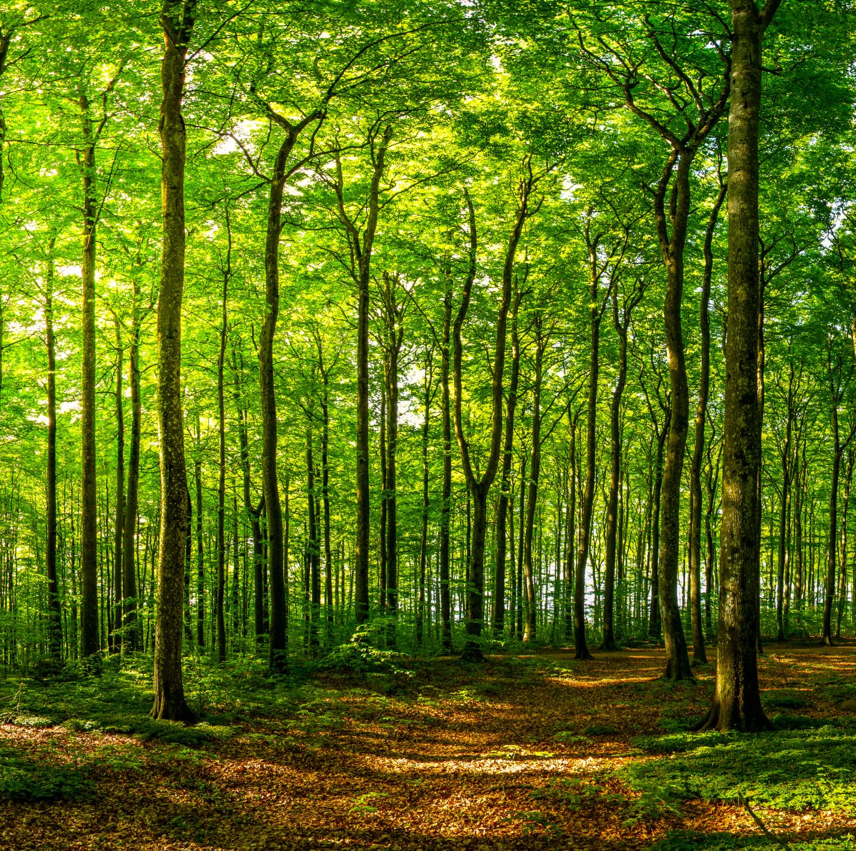
General Costs of Trees
Purchasing
Planting
Maintaining
Assessing current tree inventory
Monitoring and protection
Tree removal
Notes:
-Assessing current tree inventory (like what we already have to plant and have planted)
-Monitoring and protection (pest/rodent problems, gets in the way of installing pipes or damages them, falling from storms )

Slide 3
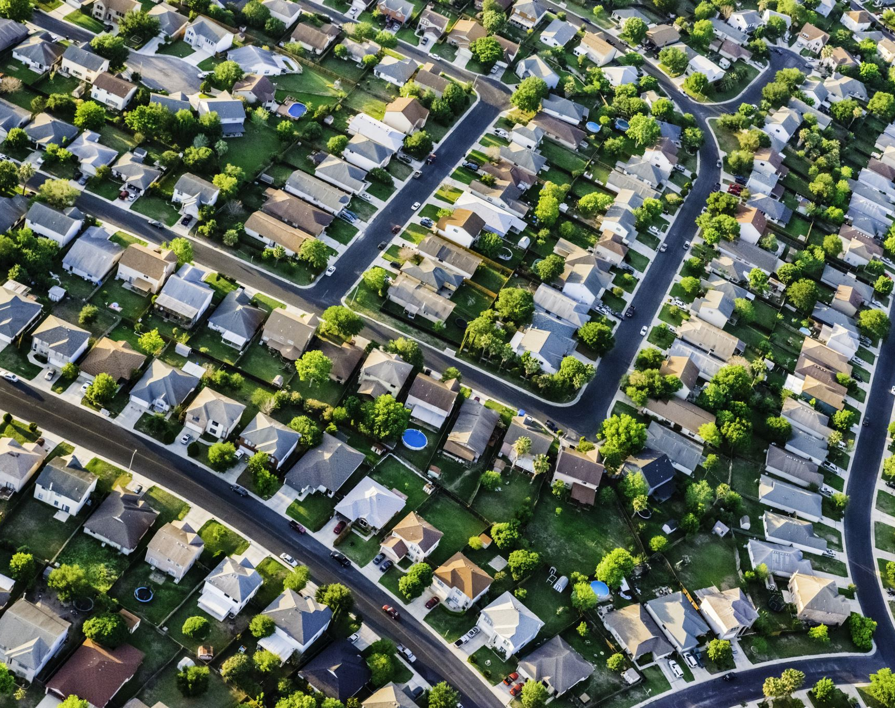
General Benefits of Trees
Aesthetics attracts commerce, residents, and improves property value by 5-10%
Maintain community asphalt roads by shading
Improves air and water quality
Reduces energy costs (up to 30%)
Increases water retention which prevents flooding and reduces erosion
Notes:
-Maintain community roads by shading (asphalt roads is stone binded by an oil and heat loosens the bind which makes the roads crack and weaker and then the traffic grinds the pavement more. Trees reduce frequency of re-pavement costs)
-Improves air and water quality (absorbing greenhouse and air pollutants gases trapped in the atmosphere during photosynthesis)
-Reduces energy costs (if near buildings, it can provide enough shade to reduce electricity use in air conditioning by 30%)
-Increases water retention which prevents flooding and reduces erosion (slows down water movement, absorbs winds and heavy rainfall)
-Projections from computer simulations indicate that 100 million mature trees in U.S. cities (three trees for every other single family home) could reduce annual energy use by 30 billion kWh, saving about 2 billion dollars in energy costs.

Slide 4
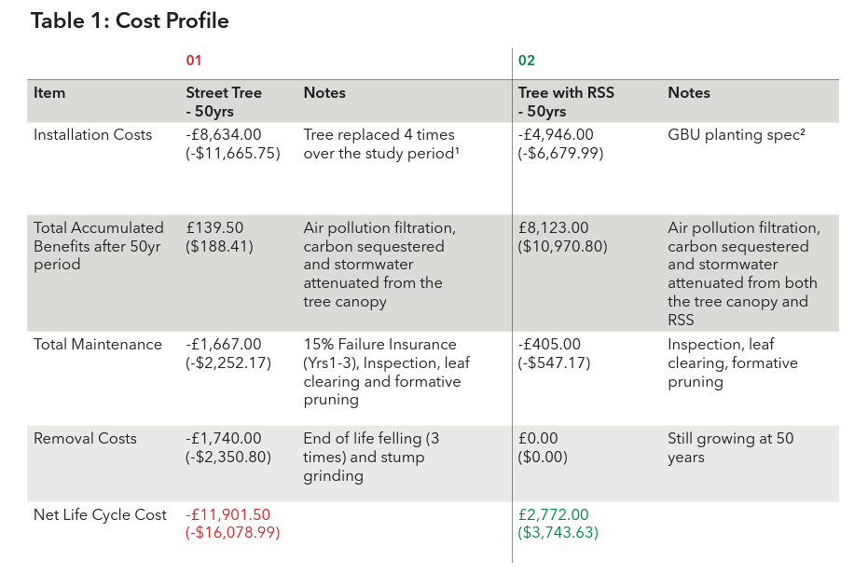
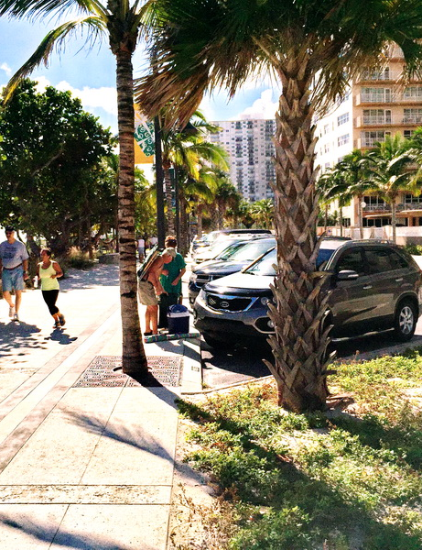
Street Pit vs RootSpace System
Notes:
RSS = RootSpace System. An underground anchoring system with more support, space, and drainage
RSS vs Standard tree pit

Slide 5
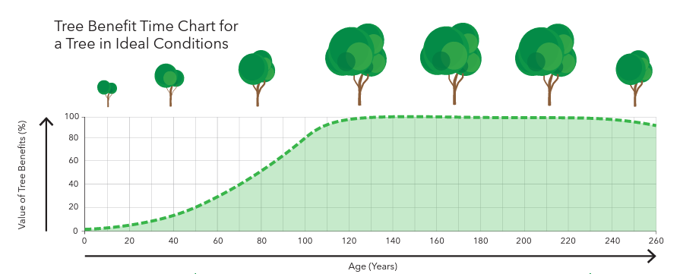

Slide 6
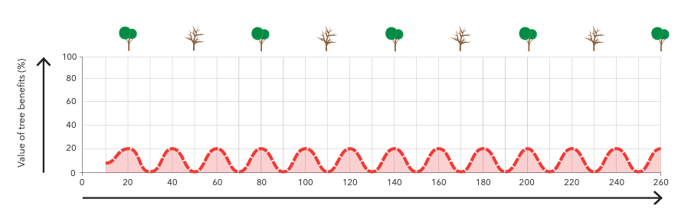

Slide 7
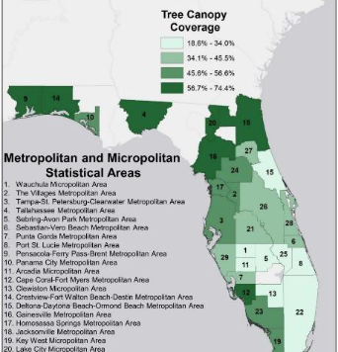
Florida’s Valuation of trees
Florida's urban forests provide an estimated $4.1 billion in annual benefits for the state
There is an estimated $76 billion in climate change benefits over their full lifespan
The average cost of planting an urban tree is $6 dollars with annual costs around $22-$27 dollars(respective to their size).
A category 4 hurricane is estimated to reduce tree coverage in an affected area by 7.7%.
Florida leads the United States in urban tree loss
Florida cities, on average, have twice the private tree protection laws in place compared to the national average.

Slide 8
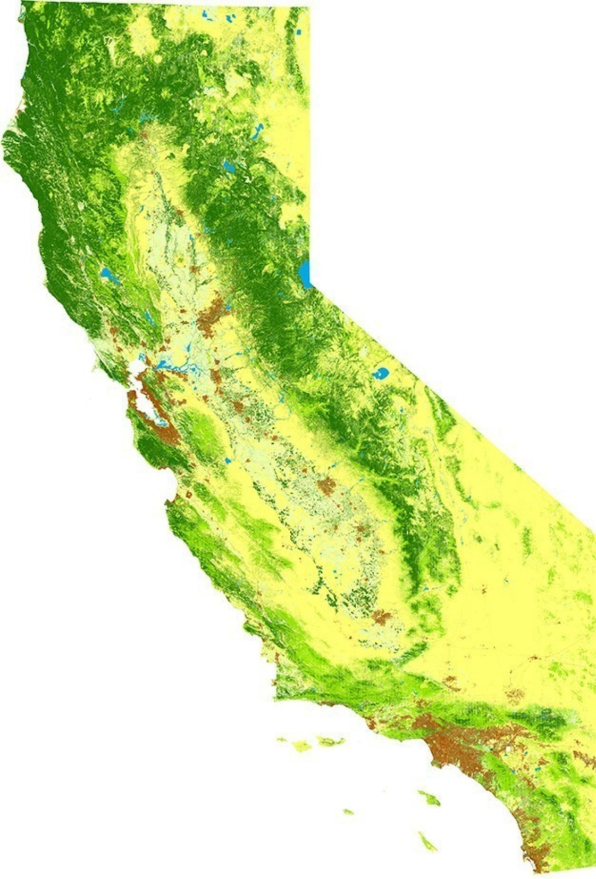
California’s Valuation of Trees
An urban forest in LA provides $111,810 of benefits per year
Every dollar spent in an urban tree yields $5.82 in benefits, given an average annual per tree management cost of $19.00
It is estimated that trees remove 9000 lbs. of air pollution per year with an associated value of $49,486.09 in LA

Slide 9
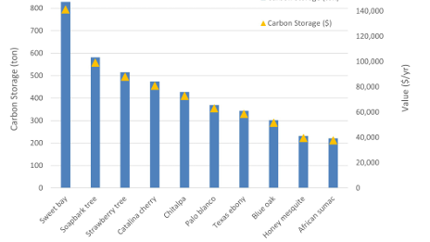
Tons of carbons absorbed and its value by California tree species
Notes:
Tons of carbons absorbed and its value by California tree species

Slide 10
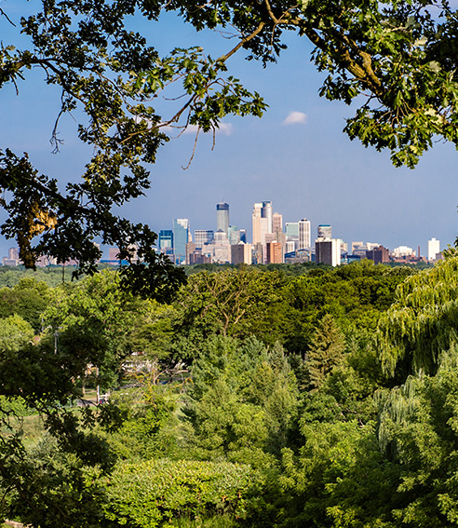
United States Urban Forests
Overall, there are an estimated 5.5 billion trees (39.4% tree cover) in urban areas across the U.S.
They provide a $73 billion benefit to society from environmental benefits
The urban forestry sector directly contributes $35 billion annually to the U.S. economy.
Estimates for tree costs in the U.S. range from $12.87 to $65 per tree annually ($39 average).

Slide 11
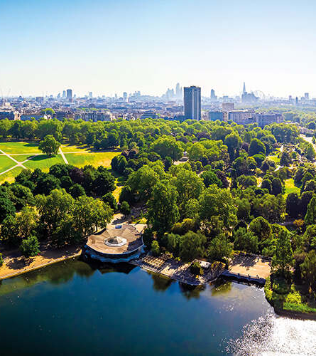
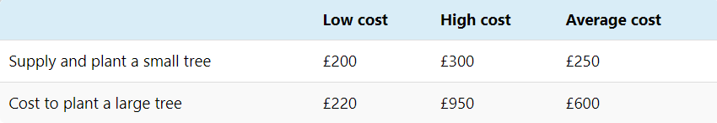
England’s Urban Forest’s
20% of England’s forests are Urban trees
Half to two-thirds of the benefits associated with these trees account for CO2 removal/storage.
Trees have an estimated economic valve of 1.39B-3.83B euros a year.
The estimated value of Urban trees in the UK is 4.9B euros.

Slide 12
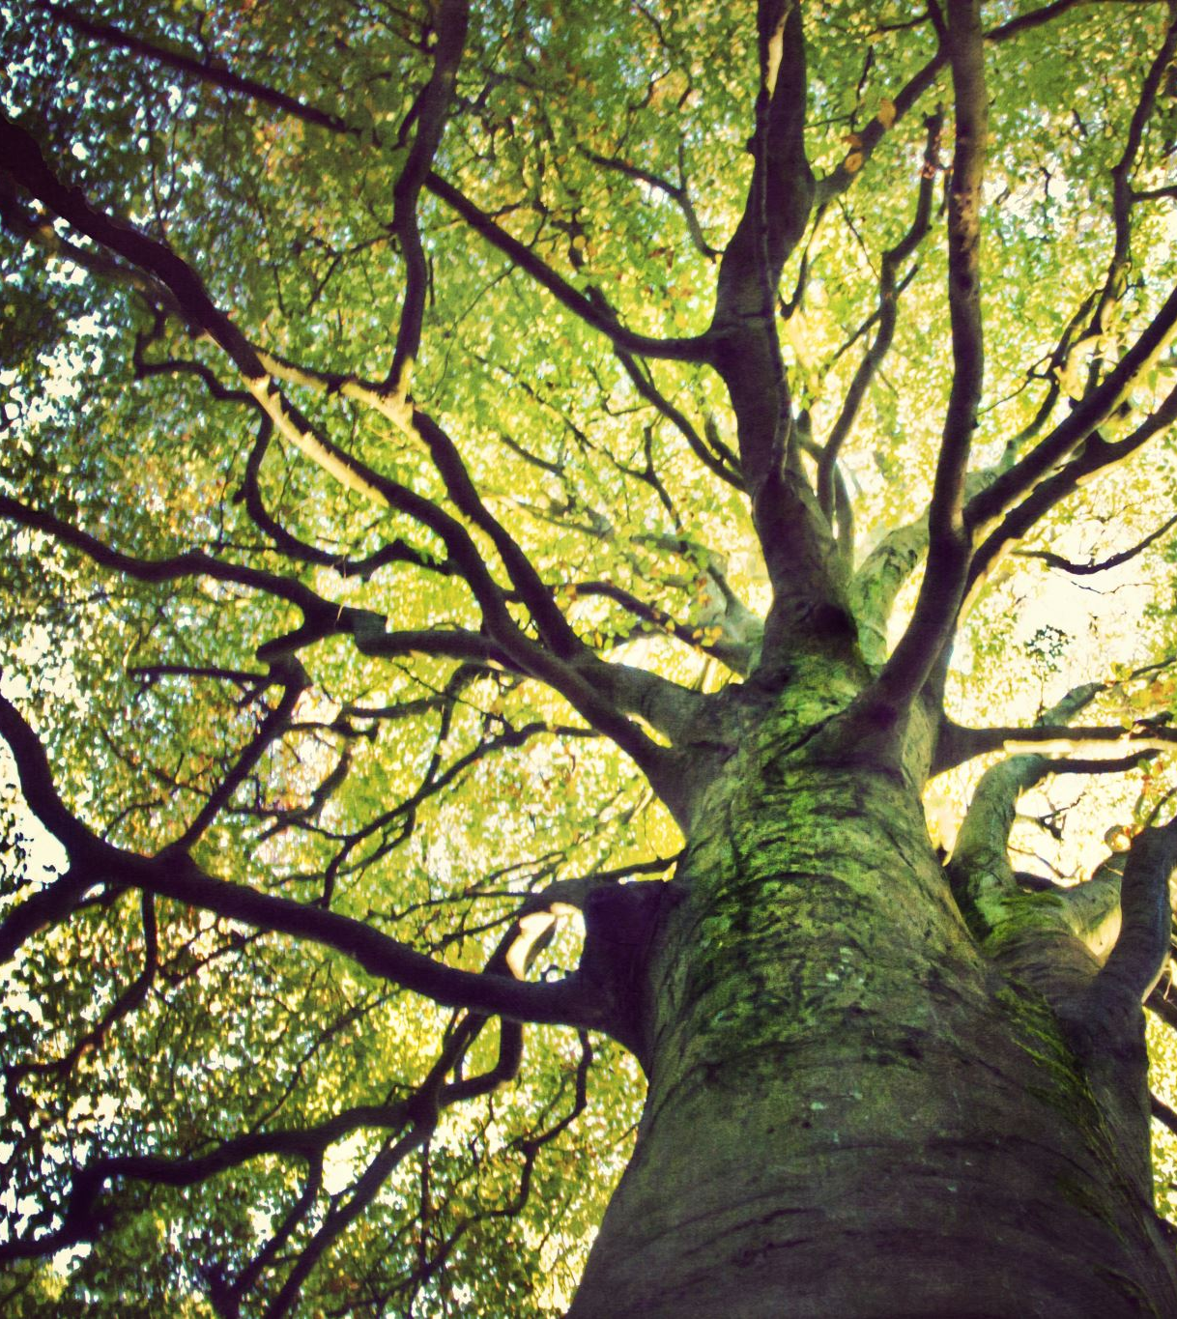
Article Summary
Sheffield, an English city, is praised for its commitment to being green with the most trees per person in England (7 trees per person)
Political controversy arose when the local government was cutting trees at a large level
The city council argued that the trees were near their useful life cycle, and opposition believed that the trees being cut had decades left to live
Costs of trees are easier to see than the benefits of trees, and city council accountants inflate costs. Tree experts from Institute of Chartered forests responds with the CAI/MAI approach
Notes:
Sheffield, an English city, is praised for its commitment to being green with the most trees per person in England (7 trees per person)
Political controversy arose when the local government was cutting trees at a large level
The city council argued that the trees were near their useful life cycle, and opposition believed that the trees being cut had decades left to live
Costs of trees are easier to see than the benefits of trees, and city council accountants inflate costs. Tree experts from Institute of Chartered forests responds with the CAI/MAI approach

Slide 13
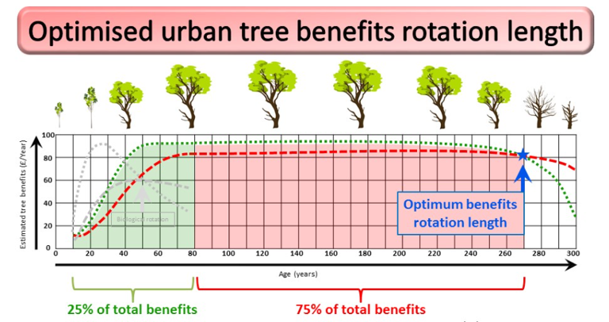
Approach to estimating the optimum rotation length for urban trees based on financial benefits they provide.
The Biological rotation is the point where CAI and MAI meet (grey dots)
The current annual tree benefits curve ( green) and mean annual tree benefit (red) cross at “optimum rotation length”

Slide 14
Article Opinion
Felling at biological rotation is not ideal for the typical urban areas
Issue with Emphasizing Timber Yield vs Optimum Rotation
Sheffield is an exception due too large number of trees
Notes:
The biological rotation approach that the tree experts from the Institute of Chartered Foresters is not the ideal way to assess the value of the typical urban tree
This approach emphasizes the benefit of optimal timber yield, but most urban areas will not have enough trees to cut to consider cutting trees for the purpose of trading timber
Not to say the biological approach is not a fit method for Sheffield given the vast volume trees in Sheffield

Slide 15
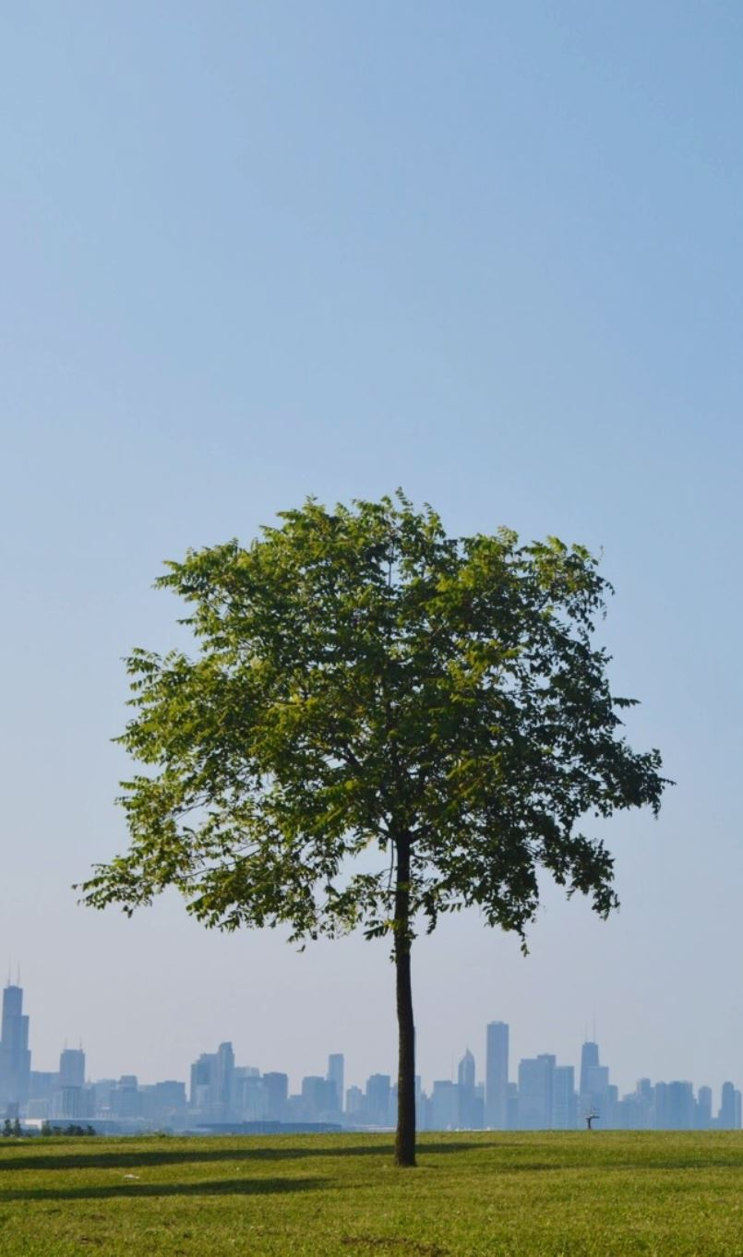
Sources and Q/A
https://www.charteredforesters.org/tree-benefits
http://urbanforestrynetwork.org/costs/cost%20benefit.htmttps://blogs.ifas.ufl.edu/hillsboroughco/2020/06/01/calculating-the-costs-and-benefits-of-urban-trees-in-central-florida/
https://www.frontiersin.org/articles/10.3389/ffgc.2022.742157/full
https://community-planning.extension.org/urban-forests-understanding-associated-costs/#:~:text=A%20community%20receives%20many%20benefits,per%20tree%20(McPherson%20et%20al.
https://geographical.co.uk/science-environment/the-value-of-city-trees#:~:text=Yet%20that's%20exactly%20what%20the,%C2%A33.83%20billion%20a%20year.
//www.mdpi.com/2076-0760/9/6/100
https://www.treeconomics.co.uk/wp-content/uploads/2018/08/GBU_Street-Tree-Cost-Benefit-Analysis-2018.pdf

